Slide 1


Introduction
Center for Animal Disease Modeling and Surveillance (CADMS),
School of Veterinary Medicine, UC Davis
Jose Pablo Gomez, Jerome Baron, Shadira Gordon
Beatriz Martinez Lopez
Center for Animal Disease Modeling and Surveillance (CADMS)
Department of Medicine & Epidemiology
School of Veterinary Medicine
University of California, Davis
* Contact: jpgo@ucdavis.edu
https://cadms.vetmed.ucdavis.edu

Slide 2
Objectives
Understand the key concepts in network analysis
How to define a network
Calculate and understand network statistics
Visualize networks using spatial and non-spatial approaches
Interpret results from a network analysis
Advantages and disadvantages of static and dynamic networks
How to incorporate spatio-temporal relationships in our analysis
Introduction to network-based models

Slide 3
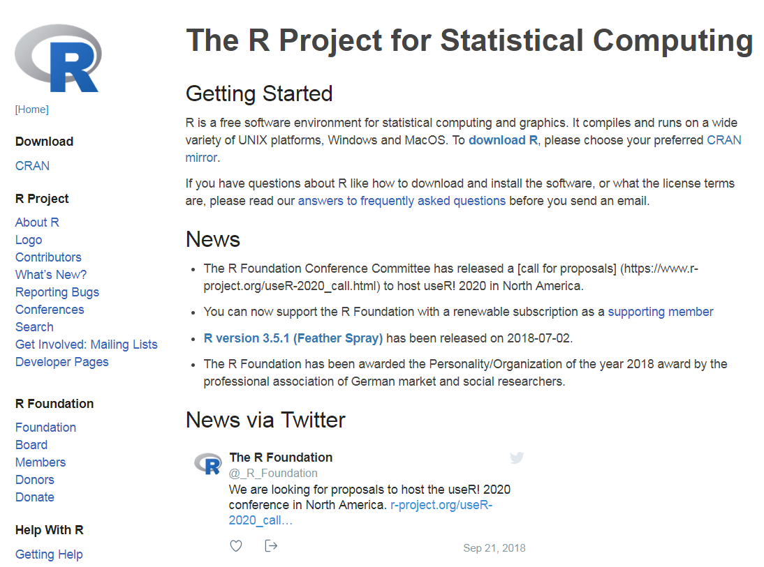
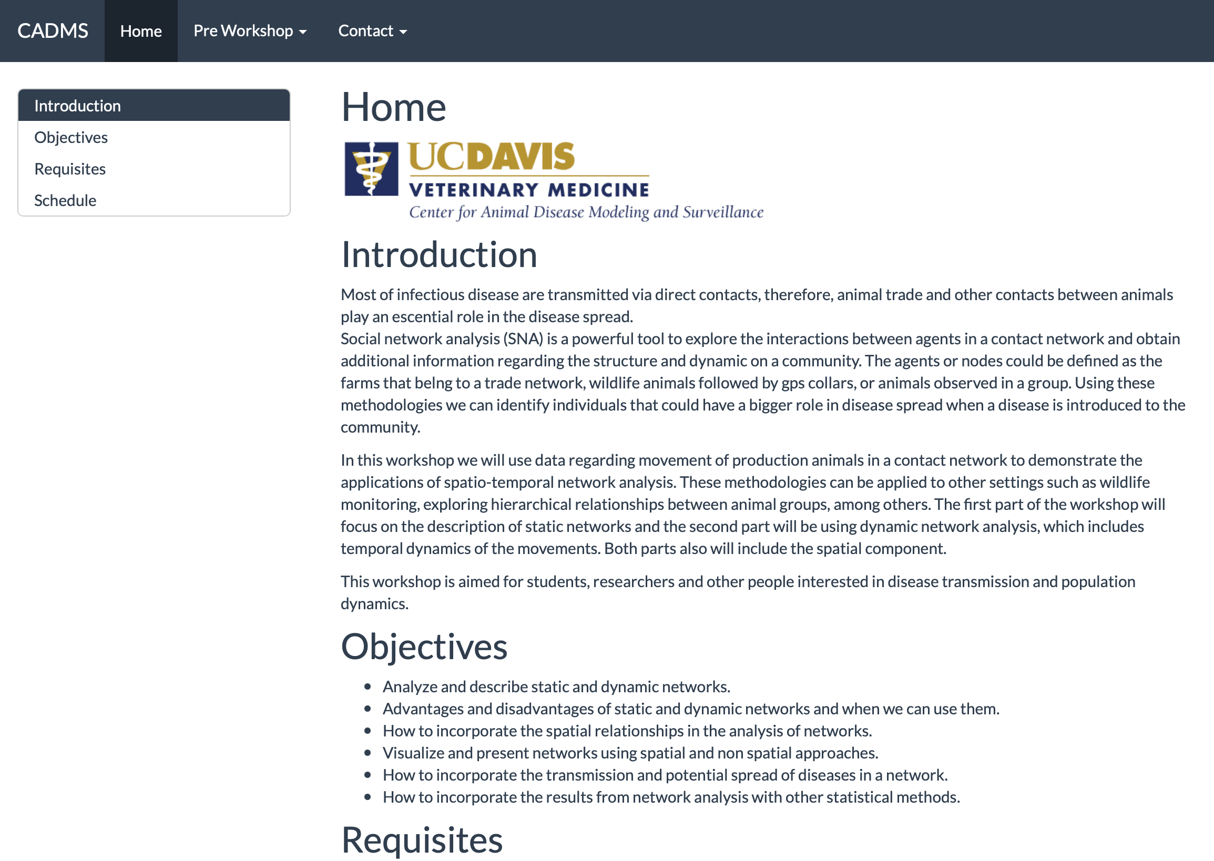

Course structure
Website: cadms-ucd.github.io/spatialnetworks_ws/
Package: STNet
Install.packages(devtools)
devtools::install_github(“jpablo91/STNet)
Notes:
We will be using R and Rstudio, hopefully everyone had a chance to install it, and we will be using this website as our main home for the course.

Slide 4
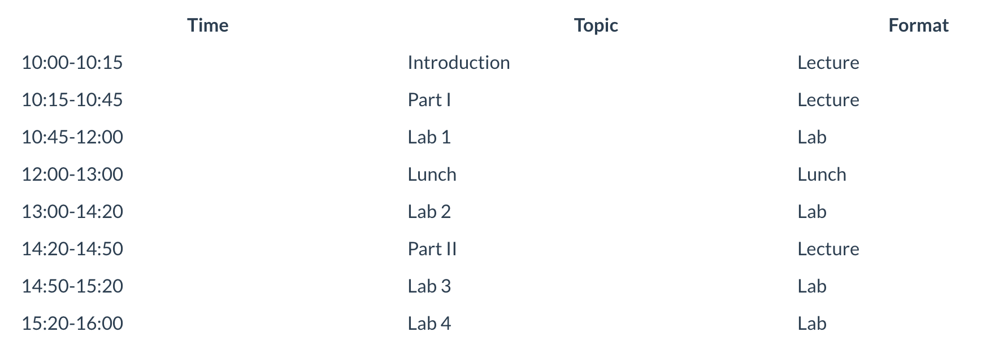
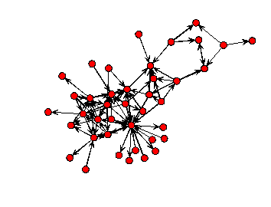
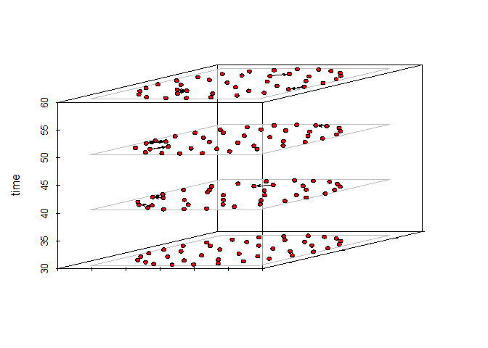
Course structure
Notes:
This is the schedule for today.
In lab 1 we will also have some time to solve some questions from the pre-workshop materials, if there are any, but the idea is that we try to move all together trough the labs.
If for some reason you don’t finish the lab, don’t stress about it, we will provide you a checkpoint so you can just run it and start the next lab and don’t fall behind.

Slide 5
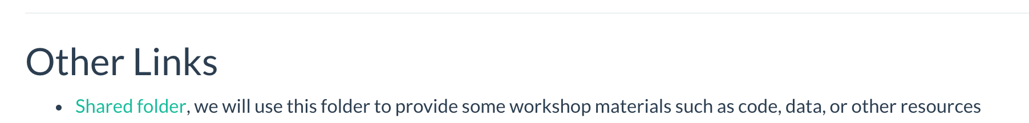
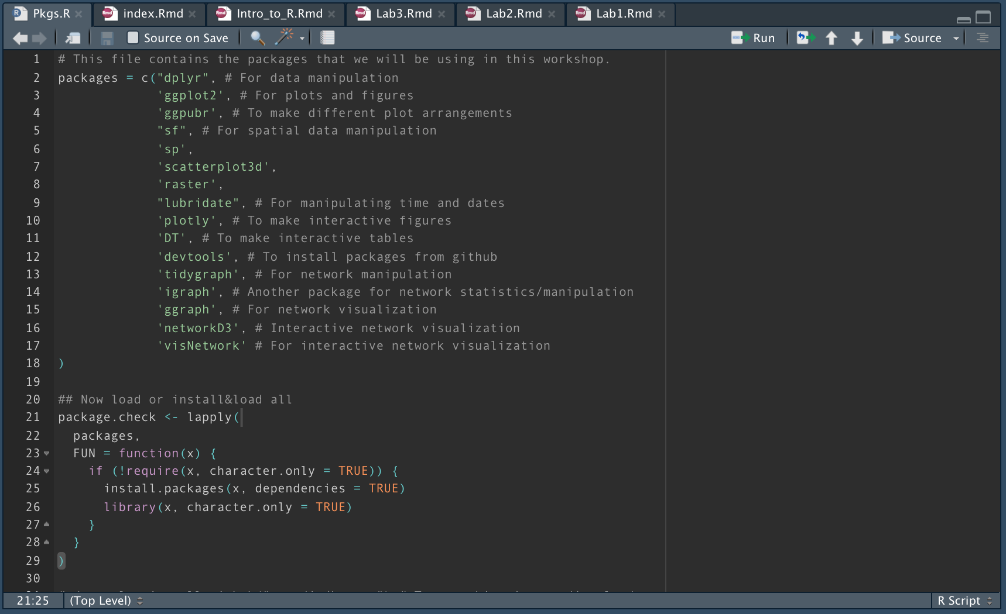
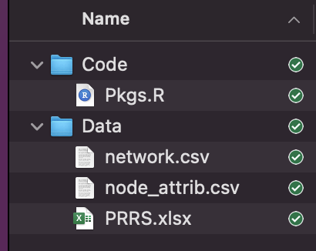
Course structure
Website: cadms-ucd.github.io/spatialnetworks_ws/

Slide 6
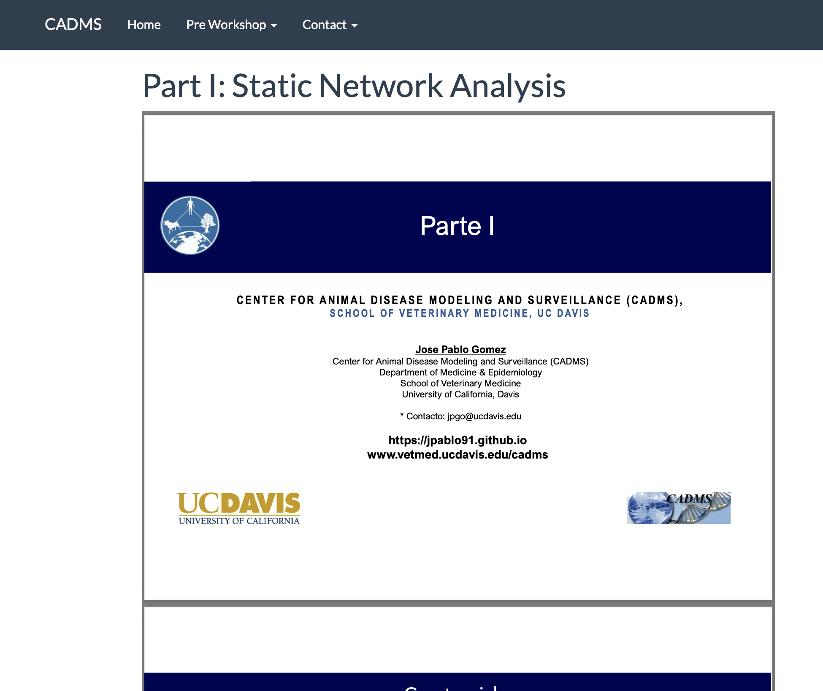
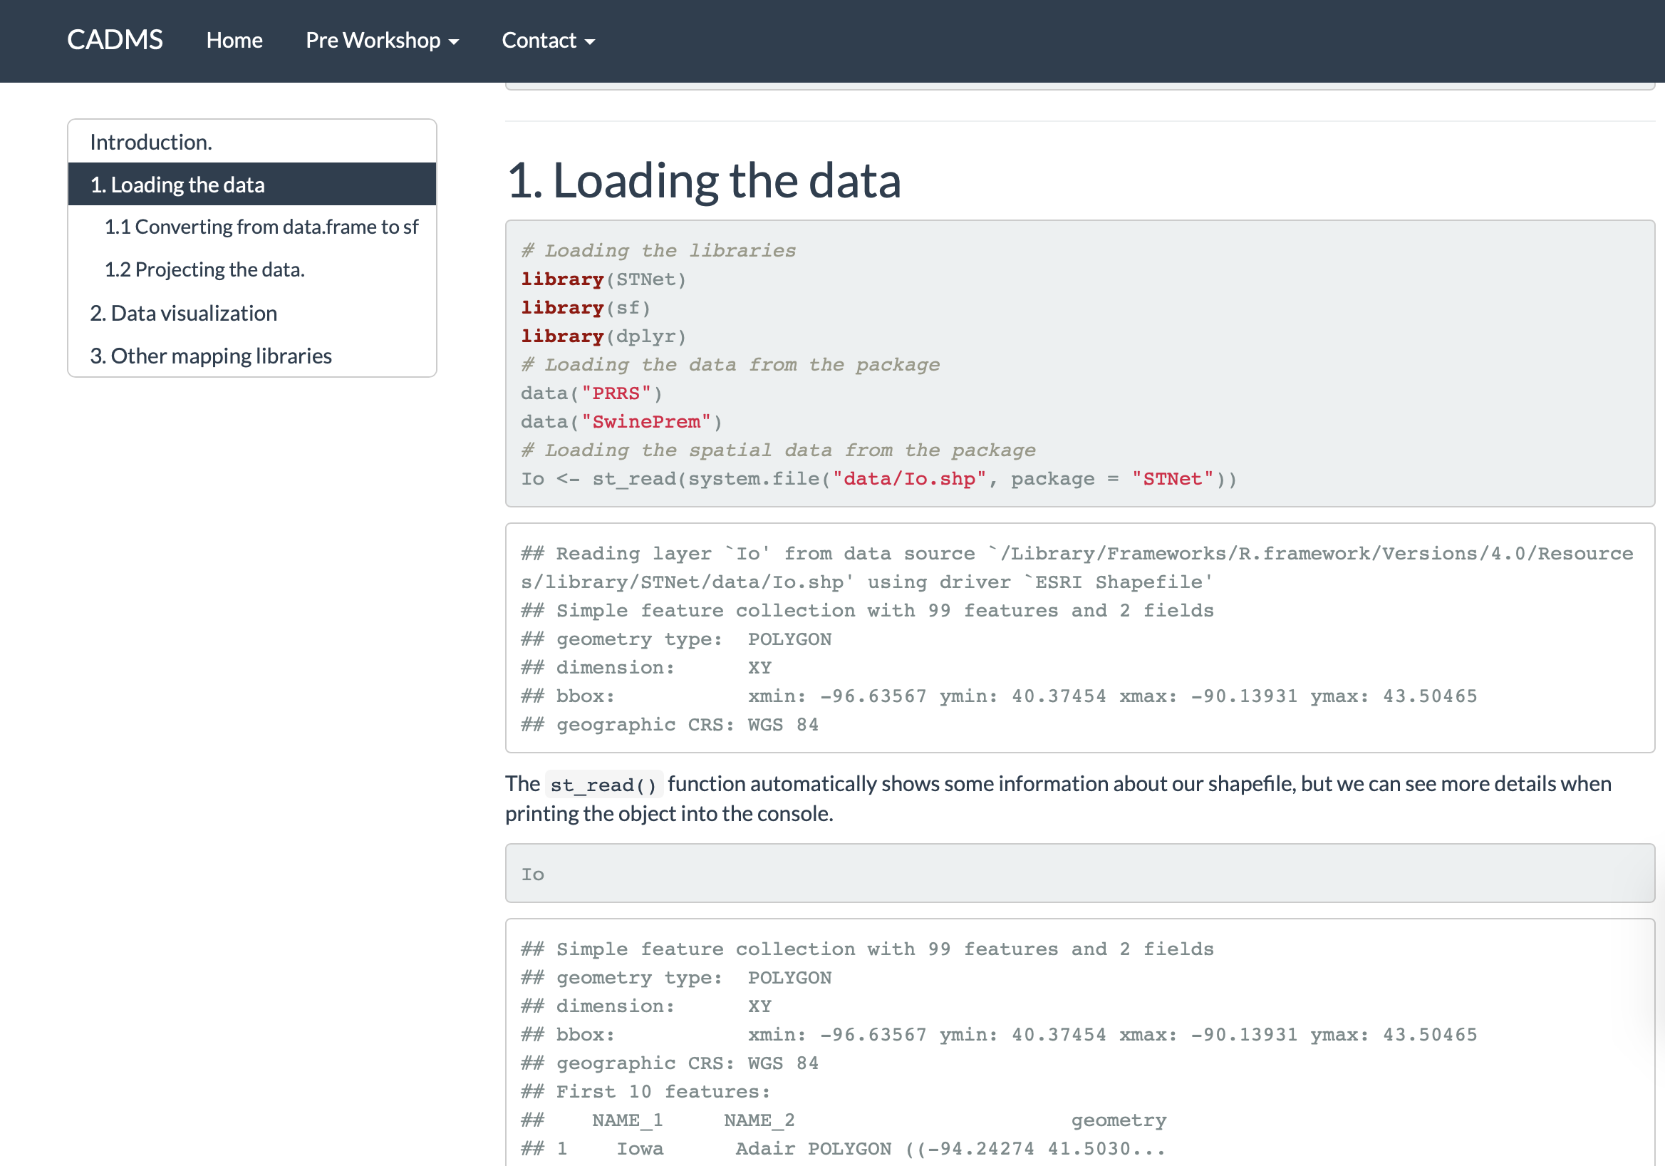
Course structure

Slide 7
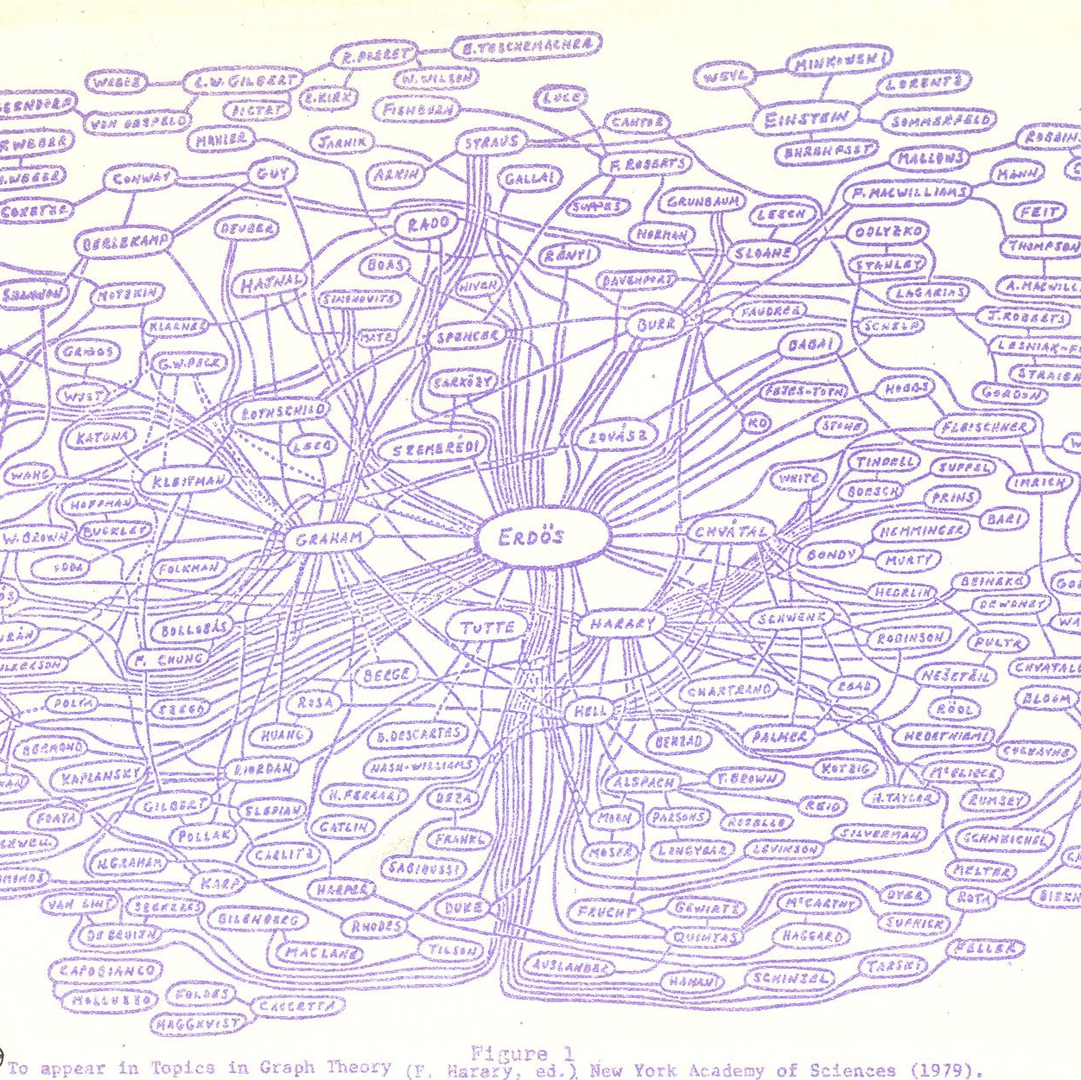
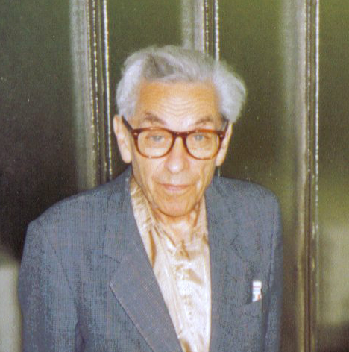
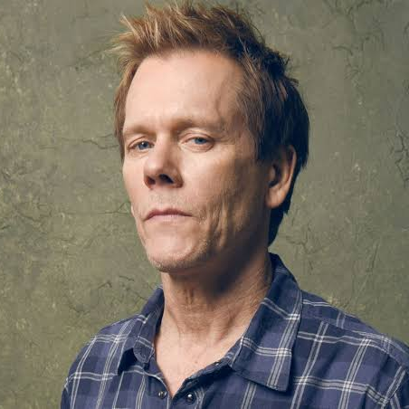

Initial Motivation
Erdos number
Bacon number
4
2
Danika McKellar
Notes:
Erdos was a mathematician that had a lot of publications with around 1500 papers and 500 collaborators
Kevin Bacon is an actor very popular from the 90s, he was in a lot of movies
Both have something in common which is that they have a long list of people they have worked with. People in the film industry and research have come up with a index that tells how many degrees of separation they have with each of these persons. In the case of Erdos one degree of separation means that a person published a paper with and for Bacon is if a person appeared in a movie with him.

Slide 8
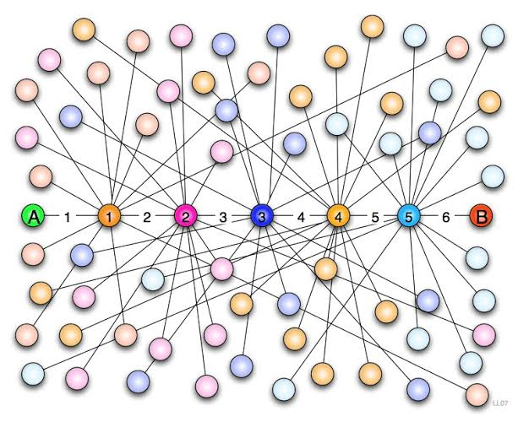
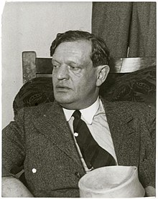

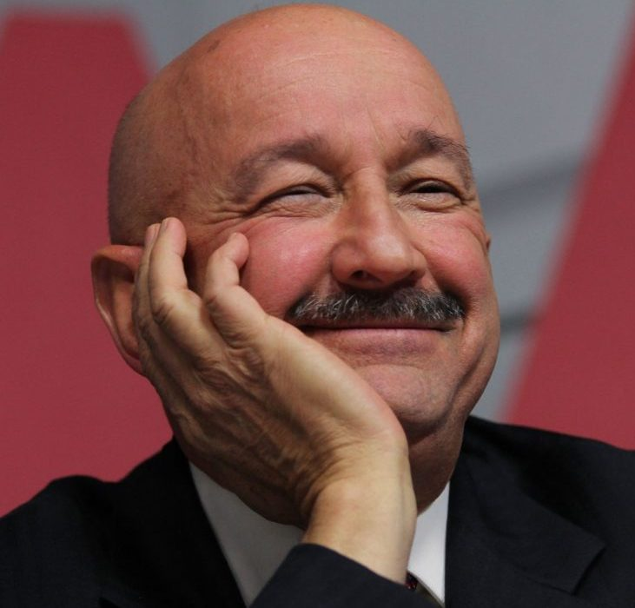

Initial Motivation
Six degrees of separation
Frigyes Karinthy 1929
Notes:
Frigyes Karinthy era un escritor que propuso la idea de que cualquier persona estaba conectada a otra por maximo 6 grados de separacion
Desde hace tiempo existe este concepto de que existen 6 grados de separacion con cualquier persona en el mundo. El amigo del amigo del amigo del amigo de mi amigo es amigo de Salinas de gortari

Slide 9


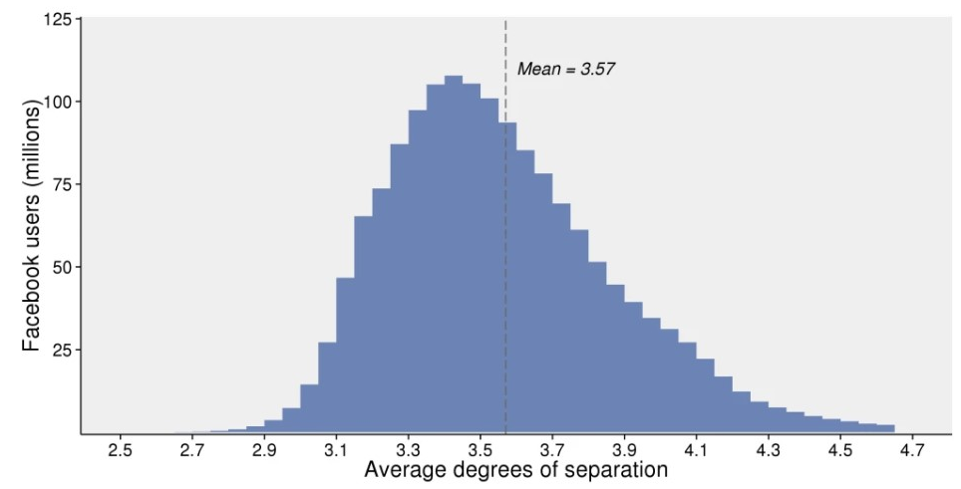
Initial Motivation
Notes:
En 2016, facebook hizo un reporte en el que analizaron los grados de separacion de los usuarios con cualquier otro usuario y la media de separacion reportada fue de 3.57.
No solo la comunicacion entre personas ha mejorada, tambien la cantidad de datos disponibles, p.e. los datos para rastreo por gps son mas accesibles.

Slide 10
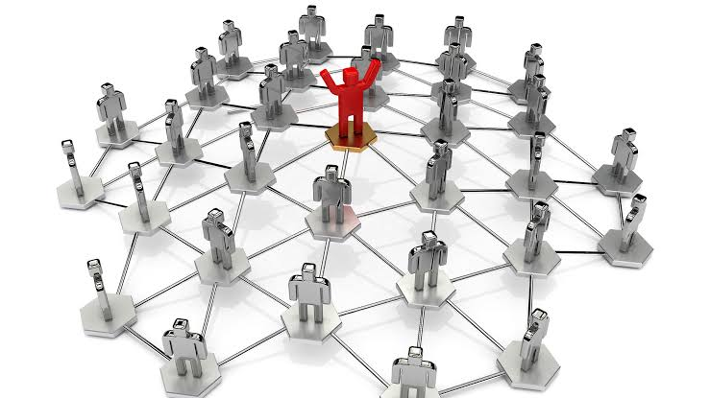
Initial Motivation
Notes:
El analisis de redes sociales ofree herramientas para analizar este tipo de informacion
En analisis de redes creemos que lo que hacen mis vecinos me afecta a mi y que la seleccion de mis vecinos suele ser afectada por ciertas caracteristicas.

Slide 11
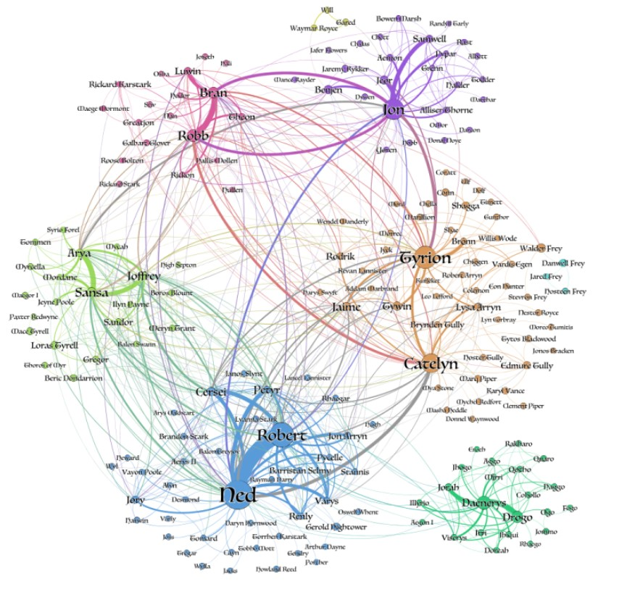
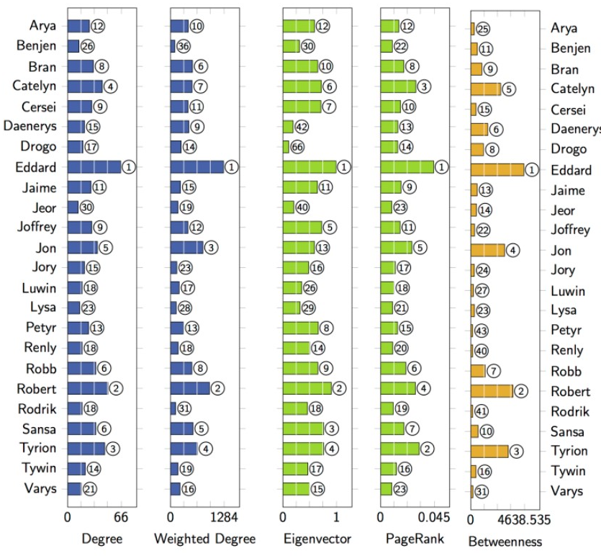
Initial Motivation
Source: https://networkofthrones.wordpress.com/the-novels/a-game-of-thrones/

Slide 12
Questions?
Contact: jpgo@ucdavis.edu
http://www.spablo-temporal.network

